Slide 1


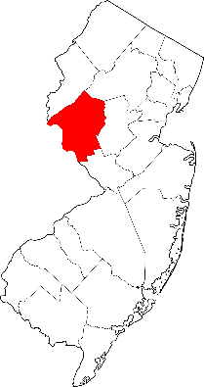


Hunterdon County
A Profile of Family and Community Indicators

Slide 2

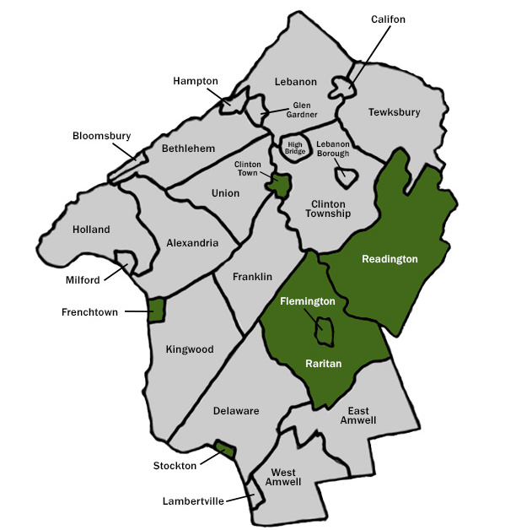

Hunterdon County
New Jersey

Slide 3
Note: Additional data can be found in workbook.

Slide 4
Note: Additional data can be found in workbook.

Slide 5
Note: Additional data can be found in workbook.

Slide 6
Note: Additional data can be found in workbook.

Slide 7
Note: Additional data can be found in workbook.

Slide 8
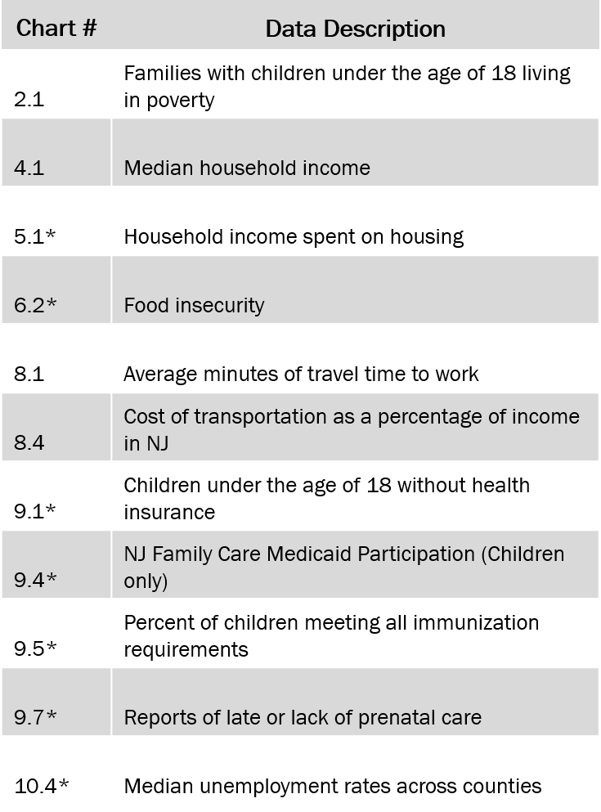
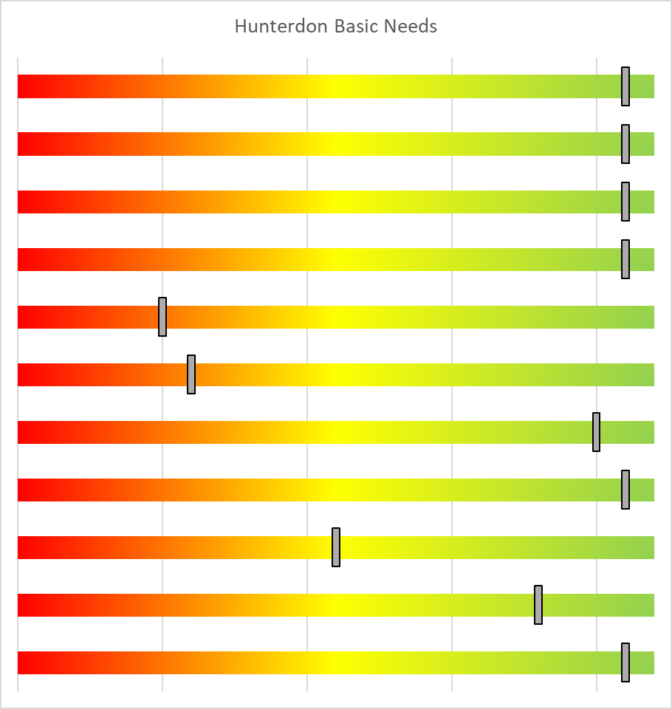
0.1 Overview – Hunterdon County Basic Needs
Compared to Other Counties
Greater Need
Lesser Need
Notes:
Slider location indicates the level of need for this county (from Greater Need to Lesser Need), as compared to other counties in NJ. Some comparisons are based on count data, while other comparisons are based on percentage data. See full chart (# listed in first column) for more details.
Note: When considering areas of need and reviewing charts, keep in mind:
Percentages are comparable across counties, whether counties have large or small total population sizes.
Count data can also compare counties, but counts tend to increase as county population size increases. In other words, counts may indicate the total number of children or families with a need, but may not indicate how well or poorly a county is addressing that need.

Slide 9
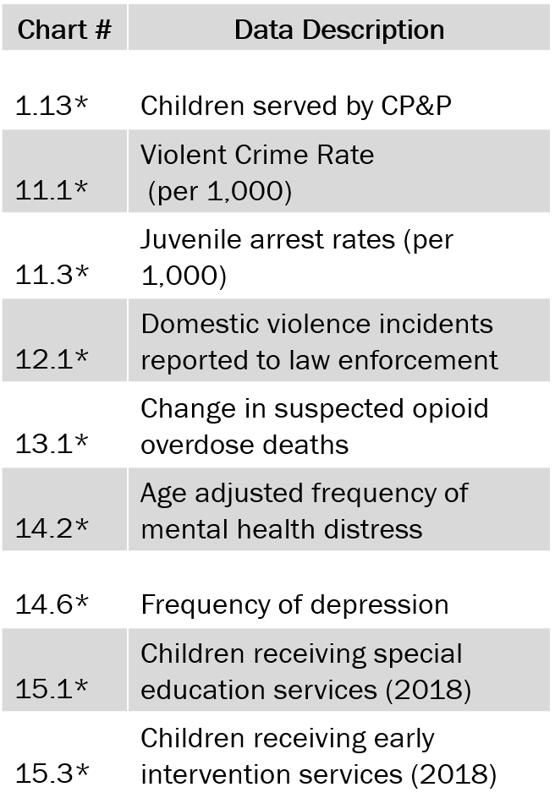
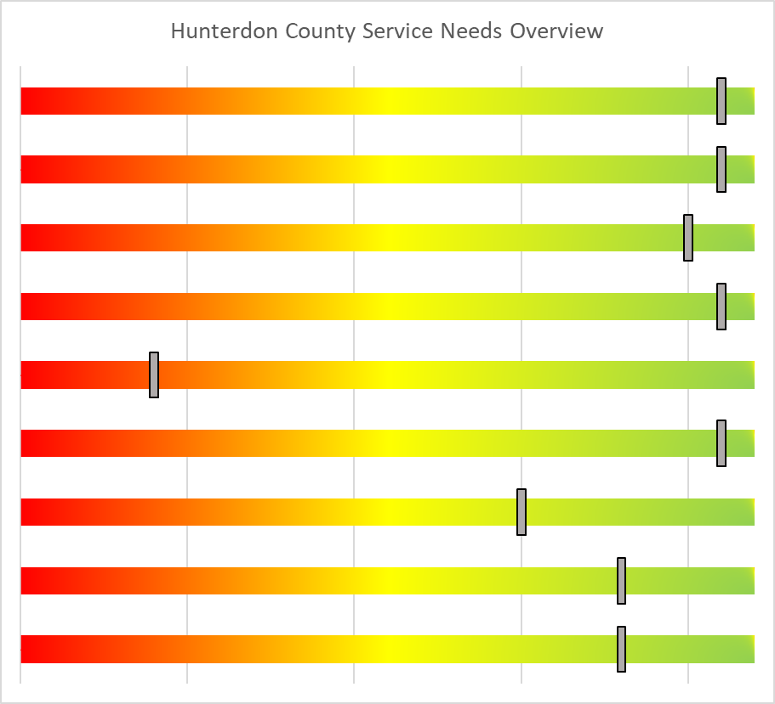
0.2 Overview – Hunterdon County Service Needs
Compared to Other Counties
Greater Need
Lesser Need
Notes:
Slider location indicates the level of need for this county (from Greater Need to Lesser Need), as compared to other counties in NJ. Some comparisons are based on count data, while other comparisons are based on percentage data. See full chart (# listed in first column) for more details.
Note: When considering areas of need and reviewing charts, keep in mind:
Percentages are comparable across counties, whether counties have large or small total population sizes.
Count data can also compare counties, but counts tend to increase as county population size increases. In other words, counts may indicate the total number of children or families with a need, but may not indicate how well or poorly a county is addressing that need.

Slide 11
1.1 Racial/ethnic demographics (%)
Source: 5-yr American Community Survey, estimates 2017
Demographics
Race/Ethnicity
Note. Percentages add up to more than 100% because respondents to the 2017 American Community Survey were able to select more than one race. Additionally, Hispanic/Latino was a separate question from race that all respondents answered before selecting race.
Notes:
Differences between the county and the state’s demographic make-up include higher proportions of White residents, and lower proportions of all other racial/ethnic groups in this county.
Municipality data available? Chart 1.3.

Slide 12
1.2 Racial/ethnic demographics (%) over time, in county
Source: 5-yr American Community Survey, estimates 2013-17
Demographics
Race/Ethnicity
Note. Percentages add up to more than 100% because respondents to the 2017 American Community Survey were able to select more than one race. Additionally, Hispanic/Latino was a separate question from race that all respondents answered before selecting race.
Notes:
Over the last 5 years for which we have Census data, this county’s proportion of all racial/ethnic groups has remained steady.
Municipality data available? Chart 1.3.

Slide 13
1.3. Illustration of diversity by municipality (%)
Source: 5-yr American Community Survey, estimates 2017
Demographics
Race/Ethnicity
Highest percentage of white residents
Middling percentage of white residents
Lowest percentage of white residents
Three municipalities were selected to illustrate how diversity ranges within the county
Note. Percentages add up to more than 100% because respondents to the 2017 American Community Survey were able to select more than one race. Additionally, Hispanic/Latino was a separate question from race that all respondents answered before selecting race.
Notes:
Stockton, West Amwell, and Flemington are composed of mostly White residents, however Flemington includes larger percentages of Asian and Hispanic/Latino residents.
To illustrate range of county diversity, municipalities are organized by highest, midrange, and lowest percentages of White residents, as this is the largest racial demographic in the state (70%).
Note: Percentages within municipality do not add up to 100% as individuals can identify as more than 1 race.
County workbook may include data for additional municipalities.

Slide 14
1.4. Population (%) foreign-born in NJ (by county)
Source: 5-yr American Community Survey, estimates 2017
Demographics
Nativity
1.5. Population (%) foreign-born over time, in county
Source: 5-yr American Community Survey, estimates 2013-17
Foreign-born refers to those who were not a US citizen at birth
Notes:
This county’s percentage of foreign-born residents is below the state average.
This counties percentage of foreign-born residents has remained steady over the past 5 years.
Municipality data available? Chart 1.6.

Slide 15
1.6. Population (%) foreign-born by municipality
Source: 5-yr American Community Survey, estimates 2017
Demographics
Nativity
Note: The 10 municipalities with the highest percentage of foreign born are displayed
Foreign-born refers to those who were not a US citizen at birth
Notes:
Of the municipalities with data available for this county, Flemington and Clinton Town have the highest proportions of foreign-born residents.
County workbook may include data for additional municipalities.

Slide 16
1.7. Population (%) English-only speakers in NJ (by county)
Source: 5-yr American Community Survey, estimates 2017
Demographics
Language
1.8. Population (%) English only speakers over time, in county
Source: 5-yr American Community Survey, estimates 2013-17
Notes:
In this county, the proportion of residents who speak English ONLY is above the state average.
In this county, the percentage of the population who speaks English ONLY has remained steady over the 5 years for which we have data.
Municipality data available? Chart 1.9.

Slide 17
1.9 Illustration of English-only speakers (%) by municipality
Source: 5-yr American Community Survey, estimates 2017
Lowest % of English-Only speakers
Demographics
Language
Middling % of English-Only speakers
Highest % of English-Only speakers
Note: Three municipalities were selected to illustrate how diversity ranges within the county
Notes:
Of the municipalities with data available for this county, Flemington has the lowest proportion of residents who speak English-only, while Califon has the highest proportion of residents who speak English-only.
To illustrate variation of language in this county, municipalities are organized by highest, midrange, and lowest percentages of English-only language speakers.
County workbook may include data for additional municipalities.

Slide 18
1.10 Children (#) under age 18 in NJ (by county)
Source: 5-yr American Community Survey, estimates 2017
Demographics
Children < 18
Note that county population size has not been accounted for in this indicator.
Notes:
The total number of children in this county is the 4th lowest in NJ. (Note that total county population size has not been accounted for in this indicator).

Slide 19
1.11 Children (# and relative percentages) per age category in NJ (by county)
Source: 5-yr American Community Survey, estimates 2017
Demographics
Children < 18
Note. The number of children estimated to be in group settings across the state (5,630 or 0.28% of total youth population) is not included above.
Notes:
In this county, children between the ages of 12-17 years old is the largest group.
Municipality data available? Chart 1.12

Slide 20
1.12 Children (%) per age category by municipality
Source: 5-yr American Community Survey, estimates 2017
Demographics
Children < 18
# aged <6 / total # of children per municipality * 100
# aged 6-11 / total # of children per municipality * 100
# aged 12-17 / total # of children per municipality * 100
Note: Data shown are limited to the municipalities with available data or the 10 municipalities with the highest percentage of children aged <6. Within each municipality, age categories are presented as percentages and will add up to approximately 100%
Notes:
No municipalities have data available for this county.
County workbook includes numbers of children in each municipality, and may include data for additional municipalities.

Slide 21
1.13 Children (#) in the care of CP&P – in and out-of-home placements (by county)
Source: Department of Children and Families, December 31, 2018
Demographics
CP&P
Note. A total of 48,461 children were being served by New Jersey CP&P on December 31,2018. This includes 3,105 children with no county reported. Note that total county population size has not been accounted for in this indicator.
Notes:
At the point in time of December 31, 2018, this county had the lowest number of children served by CP&P of NJ counties. (Note that county population size has not been accounted for in this indicator).
The number of children served (from workbook and the table behind graph 1.13):
In-home: 295
Out-of-home placement: 29
In NJ, the numbers of children served:
42,918 (in-home); 5,543 (out-of-home placement); 48,461 (total)
Note: As this data is from a single point-in-time (last day of the 2018 calendar year) the number of children served in total across the full year by CP&P would be higher.

Slide 22
1.14 Children (#) in CP&P out-of-home placement – kin and non-kin, in county
Source: Department of Children and Families, December 31, 2018
Demographics
CP&P
Note: Non-Kinship Placements include placements with non-kinship resource families, congregate care, and independent living. (Indicator to be included in the HSAC final report). Note that total county population size has not been accounted for in this indicator.
Notes:
At the point in time of December 31 each year, the number of children in CP&P out-of-home placements was lower than the previous years except 2016 and 2017.
Note: As this data is from a single point-in-time (last day of the 2018 calendar year) the number of children served in total across the full year by CP&P would be higher.

Slide 24
2.1. NJ families (%) with children under the age of 18 living in poverty (by county)
Source: 5-yr American Community Survey, estimates 2017
Poverty
2.2. Families (%) with children under the age of 18 living in poverty over time, in county
Source: 5-yr American Community Survey, estimates 2013-17
Explanation. Families “living in poverty” earn an income below the threshold appropriate for that person’s family size and composition. Federal guidelines can be found at https://aspe.hhs.gov/poverty-guidelines
Notes:
This county has a lower percentage of families living in poverty than the NJ average.
6 counties in NJ have higher percentages of families living in poverty than the national average.
The percentage of families living in poverty has remained steady between 2013 and 2017.
Municipality data available? Chart 2.3.
Poverty definition: The Census Bureau uses a set of dollar value thresholds that vary by family size and composition to determine who is in poverty.
To determine a person's poverty status, one compares the person’s total family income in the last 12 months with the poverty threshold appropriate for that person's family size and composition. If the total income of that person's family is less than the threshold appropriate for that family, then the person is considered “below the poverty level,” together with every member of his or her family. If a person is not living with anyone related by birth, marriage, or adoption, then the person's own income is compared with his or her poverty threshold. The total number of people below the poverty level is the sum of people in families and the number of unrelated individuals with incomes in the last 12 months below the poverty threshold.

Slide 25
2.3. Families (%) with children under the age of 18 living in poverty by municipality
Source: 5-yr American Community Survey estimates, 2017
Poverty
Note: The municipalities with the highest percentage of families with children under the age of 18 living in poverty are displayed
(up to 10 municipalities). Dashed line represents % of families in poverty across the county
Projection errors may reduce the accuracy of some forecasts
Explanation. Families “living in poverty” earn an income below the threshold appropriate for that person’s family size and composition. Federal guidelines can be at https://aspe.hhs.gov/poverty-guidelines
Notes:
Of the municipalities with data available for this county, Flemington and Frenchtown have the highest poverty rates in this county.
County workbook may include data for additional municipalities.

Slide 27
3.1 Monthly cost of living budget ($), by county
Source: Economic Policy Institute, 2018
Cost of
Living
The Economic Policy Institute divides the family cost of living budget into these seven components
March 2018 estimate (in 2017 dollars) for a two parent, two child family to attain a “modest yet adequate standard of living”. Estimates include costs associated with 7 components: housing, food, childcare, transportation, health care, “other necessities” and taxes.
Notes:
This county’s cost of living budget estimates how much income a family is likely to need (across 7 components) to attain a modest yet adequate standard of living here. The most costly component in this county tends to be child care, followed closely by housing.
The Economic Policy Institute’s Family Budget Calculator estimates community-specific costs for a two parent-two child family to provide a measure of economic security in America.
Municipality data available? No. An overall value for NJ is also not available.

Slide 28
3.2 Annual cost of living estimates ($) in NJ (by county)
Source: Economic Policy Institute, 2018
Cost of
Living
March 2018 estimate (in 2017 dollars) for a two parent, two child family to attain a “modest yet adequate standard of living”. Estimates include costs associated with 7 components: housing, food, childcare, transportation, health care, “other necessities” and taxes.
Notes:
This county is the most expensive NJ county to live in, based on EPI’s Family Budget Calculator total annual cost of living estimates.
The Economic Policy Institute’s Family Budget Calculator estimates community-specific costs for a two parent-two child family to provide a measure of economic security in America.
Municipality data available? No. An overall value for NJ is also not available.

Slide 30
4.1 Median household income ($) in NJ (by county)
Source: 5-yr American Community Survey estimates, 2017 inflation adjusted dollars
Income
4.2 Median household income ($) over time, in county
Source: 5-yr American Community Survey estimates, 2017 inflation adjusted dollars
Median Household Income. This figure includes the income of the householder and all other individuals 15 years old and over in a household, whether they are related or not. The median is the middle of all incomes, meaning that exactly half of all people earn more and half earn less. This is a more accurate measurement than average household income, as averages can be skewed by only a few incredibly high earners
Notes:
This county’s median household income is higher than the state median and higher than the national median.
This county’s median household income tended to increase between 2013 and 2017.
Median Household Income. This figure includes the income of the householder and all other individuals 15 years old and over in a household, whether they are related or not. The median is the middle of all incomes, meaning that exactly half of all people earn more and half earn less.
Median income tends to be a more accurate measurement than average income, as average income can be skewed by only a few incredibly high earners,
Municipality data available? Chart 4.3.

Slide 31
4.3 Median household income ($) by municipality
Source: 5-yr American Community Survey estimates, income in past 12 months, 2017 inflation adjusted dollars
Income
Note: The municipalities with the lowest median income are displayed (up to 10 municipalities).
Median Household Income. This figure includes the income of the householder and all other individuals 15 years old and over in a household, whether they are related or not. The median is the middle of all incomes, meaning that exactly half of all people earn more and half earn less. This is a more accurate measurement than average household income, as averages can be skewed by only a few incredibly high earners
Notes:
Of the municipalities with data available for this county, Flemington and Glen Gardner have the lowest median household income.
Median Household Income. This figure includes the income of the householder and all other individuals 15 years old and over in a household, whether they are related or not. The median is the middle of all incomes, meaning that exactly half of all people earn more and half earn less.
Median income tends to be a more accurate measurement than average income, as average income can be skewed by only a few incredibly high earners.
County workbook may include data for additional municipalities.

Slide 33
5.1 Households (%) with severe cost burden for housing (by county)
Source: American Community Survey (US Census), 2017 data via the Robert Wood Johnson Foundation
Housing
Burden/Problems
Explanation. 50% of income or more spent on housing is considered severe cost burden. (Indicator to be included in the HSAC final report in the Housing Overview)
Notes:
This county has a lower percentage of households experiencing severe cost burden than the NJ average.
50% of income or more spent on housing is considered severe cost burden. Household income is based on a 12-month estimate (in 2017 inflation adjusted dollars).
Municipality data available? No.

Slide 34
5.2 Households (%) with severe housing problems* over time, in county
Source: Comprehensive Housing Affordability Strategy data compiled by HUD
Housing
Burden/Problems
*Households with at least 1 of 4 housing problems: 1) Overcrowding, determined by high persons-per-room, persons-per-bedroom, or unit square footage-per-person; 2) Severe cost burden, 3) Lack of kitchen facilities, or 4) Lack of plumbing facilities.
Notes:
This county’s percentage of households experiencing severe housing burden has slightly decreased between 2014 and 2019.
Severe housing burden is defined as households with at least 1 of 4 housing problems including: overcrowding, high housing costs, lack of kitchen facilities, or lack of plumbing facilities.
The U.S. Department of Housing and Urban Development (HUD) periodically receives "custom tabulations" of data from the U.S. Census Bureau that are largely not available through standard Census products. These data, known as the "CHAS" data (Comprehensive Housing Affordability Strategy), demonstrate the extent of housing problems and housing needs, particularly for low income households. The CHAS data are used by local governments to plan how to spend HUD funds, and may also be used by HUD to distribute grant funds.
Municipality data available? No.

Slide 36
6.1 Food insecurity rates over time: county, state, and national comparisons
Source: https://map.feedingamerica.org/county/2015/overall
Food & Nutrition
Food insecurity is defined by the Life Science Research Office as the limited or uncertain availability of nutritionally adequate and safe foods or limited or uncertain ability to acquire nutritionally adequate and safe foods in societally acceptable ways. (Indicator to be included in the HSAC final report in the Food Overview)
Notes:
This county’s food insecurity rates have been decreasing slightly over time.
Nationally and in NJ, food insecurity rates have been decreasing slightly over time.
To accurately estimate the number of people who may be food insecure in every U.S. county and congressional district, Map the Meal Gap uses publicly available state and local data from the U.S. Census Bureau and Bureau of Labor Statistics on factors that research has shown to contribute to food insecurity. These factors include unemployment and poverty, as well as other demographic and household characteristics. In addition to measuring how pervasive the need is, the study also estimates the cost of a meal, and the amount of need among people who are food insecure.
Municipality Data available? No. County and state levels only.

Slide 37
6.2 Food insecurity (%) in NJ (by county)
Source: U.S. Census Bureau Current Population Survey and the U.S. Department of Agricultural Economic Research Service (2015-2017).
Food & Nutrition
Food insecurity is defined by the Life Science Research Office as the limited or uncertain availability of nutritionally adequate and safe foods or limited or uncertain ability to acquire nutritionally adequate and safe foods in societally acceptable ways.
Notes:
This county’s food insecurity rate is less than the state average and less than the national average.
Municipality Data available? No. County and state levels only.

Slide 38
6.3 Individuals (#) enrolled in WIC nutrition program, in county
Source: New Jersey Department of Health and Senior Services via Annie E Casey Kids Count
Food & Nutrition
6.4 Children (#) receiving free or reduced lunch, in county
Sources: New Jersey Department of Agriculture via Annie E Casey Kids Count; American Community Survey 2012-17 Five-Year Estimates
6.5 Children (#) receiving NJ SNAP supplemental nutrition assistance, in county
Source: New Jersey Department of Human Services, Division of Family Development via Annie E Casey
Note that total county population size has not been accounted for in these indicators.
Notes:
In this county:
The number of women, infants and children enrolled in the WIC Nutrition Program has slightly decreased between 2013 and 2017.
The number of children receiving FRL has slightly decreased between the school years shown.
The number of children receiving NJ SNAP benefits (formerly food stamps) has decreased between 2013 and 2017.
NJ SNAP, formerly Food Stamps, is New Jersey's Supplemental Nutrition Assistance Program that can help low-income families buy the groceries they need to eat healthy.
Eligibility depends on several factors like income, household size, resources, etc. Visit https://www.nj.gov/humanservices/dfd/programs/njsnap/ for information on eligibility standards and program participation
Municipality data available? No.

Slide 40
7.1: Median monthly childcare cost ($) of center-based care by age of child
Source: Rutgers University data collection on behalf of the NJ Department of Human Services, 2017
Child Care
(Indicator to be included in the HSAC final report)
Notes:
In this county, infant, toddler, and pre-K median monthly childcare costs in this county tend to be on the high side for the state.
Data includes responses from more than 1,000 daycare centers. Free daycare programs, such as Head Start, are not included in the analysis.
Municipality data available? No.

Slide 41
7.2: Median monthly child care cost ($) of center-based care by age of child compared with median household income (by county)
Child Care
Source: Rutgers University data collection on behalf of the NJ Department of Human Services, 2017
Notes:
This county’s infant, toddler and pre-K childcare costs appear as expected when compared to the county’s median household income.
Data includes responses from more than 1,000 daycare centers. Free daycare programs, such as Head Start, are not included in the analysis.
Municipality data available? No.

Slide 43
8.1: Average commute (minutes) in NJ (by county)
Source: 5-yr American Community Survey estimates, 2017
Transportation & Commute
Travel Time
8.2: Average commute (minutes) over time, in county
Source: 5-yr American Community Survey estimates, 2013-17
US avg 26.4
NJ avg 31.5
Notes:
This county’s commuters tend to have a slightly longer commute to work than the state average of 31.5 minutes.
Only 4 counties in NJ have estimated average commute times shorter than the national average.
This county’s average travel time to work has tended to remain steady over time.
Municipality data available? Chart 8.3.

Slide 44
8.3: Average commute (minutes) by municipality
Source: 5-yr American Community Survey estimates, 2017
Transportation & Commute
Travel Time
Note: The 10 municipalities with the longest commute are displayed (up to 10 municipalities)
Notes:
Of the municipalities with data available for this county, High Bridge and Alexandria have the longest average commute times.
County workbook may include data for additional municipalities.

Slide 45
8.4 Cost of transportation as a percentage of income (%) in NJ (by county)
Source: Housing and Transportation Affordability Index from Center for Neighborhood Technology, 2019, https://htaindex.cnt.org/map
Transportation & Commute
Cost
Note. % calculated from a “typical regional” family profile.
Notes:
Residents in this county spend the 6th highest proportion of their income on transportation as compared to other NJ counties.
Calculated based on "typical regional" family profile.
[The income, number of commuters and household size for the “typical regional” family profile for this county are provided in the county workbook, table 8.4].
Municipality data available? No. A NJ statewide estimate is also not available.

Slide 46
8.5 Annual Total Auto Cost ($) in NJ (by county)
Source: Housing and Transportation Affordability Index from Center for Neighborhood Technology, 2019, https://htaindex.cnt.org/total-driving-costs/
Transportation & Commute
Cost
Note. "Total Auto Cost" is the sum of "Annual Auto Ownership Cost" and "Annual Gas Cost".
Notes:
The annual cost of car ownership in this county is estimated to be the highest in the state.
Calculated based on "typical regional" family profile.
[The income, number of commuters and household size for the “typical regional” family profile for this county are provided in the county workbook, table 8.4].
Municipality data available? No. A NJ statewide estimate is also not available.

Slide 48
9.1: Children under the age of 18 (%) without health insurance in NJ (by county)
Source: 5-yr American Community Survey estimates, 2017
Health Care & Health Insurance
9.2: Children without health insurance (%) over time, in county
Source: 5-yr American Community Survey estimates, 2013-17
US avg. 5.7
Notes:
This county has a lower percentage of minors without insurance than the state average.
Only 4 counties in NJ have higher estimated percentages of children without insurance than the national average.
In this county, the percentage of minors without insurance has slightly varied over time.
Municipality data available? Chart 9.3.

Slide 49
9.3: Children (%) without health insurance by municipality
Source: 5-yr American Community Survey estimates, 2017
Health Care & Health Insurance
Note: Up to the municipalities with the highest percentage of children without health insurance are displayed
Notes:
Of the municipalities with data available for this county, Frenchtown and Flemington have the largest percentages of minors without insurance in this county.
County workbook may include data for additional municipalities.

Slide 50
9.4: NJ Family Care Medicaid participation (#) in NJ (by county)
Source: New Jersey Department of Human Services
Health Care & Health Insurance
Note: Non-ABD Medicaid is for children age 18 and younger if their family's total income before taxes is at or below 350% of the Federal Poverty Level (ex., $6,723 per month in a family of four). Parents may also be eligible if earned income is at or below 133% of the Federal Poverty Level ($2,555 monthly for a family of four)." Note that total county population size has not been account for in this indicator.
Notes:
Without accounting for population size, this county has the lowest NJ Family Care Medicaid Participation of NJ counties.

Slide 51
9.5: Children meeting all immunization requirements (%) in NJ (by county)
Source: The New Jersey annual Immunization Status Reports, 2018-2019
Health Care & Health Insurance
Note: Percentages are calculated across these grade types: Pre-Kindergarten, Kindergarten, First Grade, Sixth Grade, and Transfers. Children with unknown immunization status were considered as not having met all immunization requirements.
Notes:
Across all counties, the majority of children have met all immunization requirements.

Slide 52
9.6: County immunization rates (%) (all grade types), in county
Source: New Jersey Annual Immunization Status Reports, 2013-2019
Health Care & Health Insurance
Note: Percentages are calculated across these grade types: Pre-Kindergarten, Kindergarten, First Grade, Sixth Grade, and Transfers. Children with unknown immunization status were considered as not having met all immunization requirements.
Notes:
This county's child immunization rates have remained mostly steady between 2013 and 2019.

Slide 53
9.7: Late or lack of prenatal care reports (#) in NJ (by county)
Source: Center for Disease Control and Prevention (2017-2018)
Health Care & Health Insurance
Note: Cape May and Salem County do not have any data available. For all counties with fewer than 100,000 persons are combined together under the label "Unidentified Counties." Note that total county population size has not been accounted for in this indicator.
Notes:
Without accounting for population size, this county has the 2nd lowest report of late or lack of prenatal care of the NJ counties.
Note: Cape May and Salem Counties do not have individual data available. All counties with fewer than 100,000 persons are combined together under the label "Unidentified Counties."
Calculated as the percentage of births that occur to mothers who, on their child's birth certificate, reported receiving prenatal care only in the third trimester of their pregnancy, or who reported receiving no prenatal care.

Slide 54
9.8: Late or lack of prenatal care reports (#) over time, in county
Source: Center for Disease Control and Prevention
Health Care & Health Insurance
(Indicator to be included in the HSAC final report) Note that total county population size has not been accounted for in this indicator
Notes:
In this county, reports of late or lack of prenatal care has increased between 2017 and 2018. Data for 2017 is not available.
Note: Cape May and Salem Counties do not have individual data available. All counties with fewer than 100,000 persons are combined together under the label "Unidentified Counties."
Calculated as the percentage of births that occur to mothers who, on their child's birth certificate, reported receiving prenatal care only in the third trimester of their pregnancy, or who reported receiving no prenatal care.

Slide 56
10.1: Weekly wages ($ avg) by quarter: state and county comparison
Source: Bureau of Labor Statistics 2018 estimates
Unemployment
Wages and Rates
10.2: Weekly wages ($ avg) over time, in county
Source: Bureau of Labor Statistics 2018 estimates
Note. Average weekly wages were calculated using unrounded data. Average weekly wage in total covered all industries, for all establishment sizes in all counties.
Notes:
Employees in this county are estimated to earn a similar weekly wage than the state average.
In this county, the average annual wage has increased slightly between 2016 and 2018.

Slide 57
10.3: Monthly unemployment rate from June 2018-May 2019: state and county comparison (unadjusted)
Source: Bureau of Labor Statistics, 2018-2019
Unemployment
Wages and Rates
Unemployment is defined by the Bureau of Labor Statistics as people who don’t have a job, have actively looked for work in the past month, and are currently available for work. The unemployment rate is calculated by dividing the total number of unemployed persons with the total number of employed and unemployed persons (Indicator to be included in the HSAC final report in the Employment Overview)
Notes:
The county’s unemployment rate is generally lower than the state's rate and tended to follow similar patterns across the year.
Note: Not seasonally adjusted.

Slide 58
10.4: Median unemployment rates, June 2018-May 2019 in NJ (by county)
Source: Bureau of Labor Statistics
Unemployment
Wages and Rates
Unemployment is defined by the Bureau of Labor Statistics as people who don’t have a job, have actively looked for work in the past month, and are currently available for work. The unemployment rate is calculated by dividing the total number of unemployed persons with the total number of employed and unemployed persons (Indicator to be included in the HSAC final report in the Employment Overview)
Notes:
This county’s median unemployment rate is lower than the state median.
Note: Not seasonally adjusted.

Slide 59
10.5: Median income ($) by sex in NJ (by county)
Source: American Community Survey. Selected economic characteristics. 2013-17 American Survey, 5-yr estimates.
Employment
Income by Sex
Notes:
In this county, as with each NJ county, men tend to have higher annual incomes than women.
Municipality data available? Chart 10.8.

Slide 60
10.6: Median income ($) by sex: national, state and county comparison
Source: 5-yr American Community Survey estimates representing median earnings in dollars for full-time, year-round workers in 2017
Employment
Income by Sex
Notes:
In this county, both males and females tend to have a higher median income than the state average, and a higher median income to the national average
Municipality data available? Chart 10.8.

Slide 61
10.7: Median income ($) by sex over time, in county
Source: 5-yr American Community Survey estimates for median earnings for full-time, year-round workers, 2013-17
Employment
Income by Sex
Notes:
In this county, the median income for males and females has slightly increased between 2013 and 2017. Men consistently earn about $24K more than women.
Municipality data available? Chart 10.8.

Slide 62
10.8: Median income ($) by sex by municipality
Source: 5-yr American Community Survey estimates for median earnings for full-time, year-round workers, 2017
Employment
Income by Sex
Highest median income municipality
Middling median income municipality
Lowest median income municipality
To illustrate diversity in median income by sex, the highest, the middling, and the lowest median income municipality are provided
Notes:
Three municipalities with the highest, lowest, and a middling median income were selected to illustrate the variation of income by sex across municipalities.
County workbook may include data for additional municipalities.

Slide 64
11.1: Violent crimes (#) & crime rates (per 1,000) in NJ (by county)
Source: NJ Municipal County Offense and Demographic Data (2016)
Community Safety
Violent Crimes
(Indicator to be included in the HSAC final report)
Notes:
This county’s crime rate is lowest in the state.
Comparisons of crime rates between counties should not be made without considering seasonal population volume, transience, tourism, and labor forces.
Info: All crime rates are based on permanent, year-round populations and refer to instances of murder, rape, robbery and aggravated assault.

Slide 65
11.2: Crimes by type (#), in county
Source: NJ Municipal County Offense and Demographic Data, 2016
Violent Crimes
Nonviolent Crimes
Community Safety
Violent Crimes
Note that total county population size has not been accounted for in this indicator
Notes:
In this county, most violent crimes were attributed to aggravated assault and most nonviolent crimes were attributed to larceny.

Slide 66
11.3: Juvenile arrest rates (per 1,000) in NJ (by county)
Source: Annie E Casey Kids Count Data using raw data from NJ Department of Law and Public Safety, Division of NJ State Police, Uniform Crime Reports, updated 7.13.18
Community Safety
Juvenile Arrests
11.4: Juvenile arrest rates (per 1,000) over time
Source: Safety, Division of NJ State Police, Uniform Crime Reports. Updated 7.13.18
(Indicator to be included in the HSAC final report)
Notes:
Without accounting for population size, this county has the 2nd lowest juvenile arrest rate in the state.
This rate has decreased slightly between 2012 and 2016, and is below the rate for NJ.

Slide 67
11.5: Homicide rates (deaths per 100K) in NJ (by county) - age adjusted
Source: NJ State Health Assessment, NJ DPH, Office of Vital Statistics and Registry. 2017
*The number of deaths in all other counties are too small to calculate reliable rates
Community Safety
11.6: Homicide rates (deaths per 100K) over time - age adjusted
Homicide
Source: NJ State Health Assessment. Calculator found here: https://www-doh.state.nj.us.doh-shad/query/result/mort/MortCntylCD10/AgeRte.html
Notes:
The number of deaths was too small to calculate reliable rates for most counties, and for some years.
This county does not have available data.
County is the decedent's county of residence, not the county where the assault occurred.

Slide 68
11.7: Homicide rates (deaths per 100K) by racial/ethnic group, in county
Source: NJ State Health Assessment, NJ DPH, Office of Vital Statistics and Registry for data between 2013-2017
Community Safety
11.8: Homicide rates (deaths per 100K) by sex, in county
Homicide
Source: NJ State Health Assessment, NJ DPH, Office of Vital Statistics and Registry for data between 2013-2017
No data displayed means data are too small to calculate reliable rates.
Notes:
Blanks indicate the number of deaths was too small to calculate reliable rates. Most counties will have blanks in this section.
We cannot compare homicide rates by racial/ethnic group for this county.
We cannot compare homicide rates by sex for this county.
County is the decedent's county of residence, not the county where the assault occurred.

Slide 70
12.1: Domestic violence incidents (# reported) in NJ (by county)
Source: New Jersey State Police annual domestic violence reports, 2016
Domestic
Violence
Explanation. The NJ State Police define “domestic violence incidents” as inclusive of: Homicide, assault, terroristic threats, kidnapping, criminal restraint, false imprisonment, sexual assault, criminal sexual assault, lewdness, criminal mischief, burglary, criminal trespass, harassment & stalking. The latest data available is 2016. Note that total county population size has not been accounted for in this indicator.
Notes:
Without accounting for population size, this county has the lowest number of domestic violence incidents in NJ.
The New Jersey State Police UCR Unit relies on the individual reporting agencies for accuracy of the reported data.
Municipality data available? Chart 12.3.

Slide 71
12.2: Domestic violence incidents (# reported) over time, in county
Source: New Jersey State Police annual domestic violence reports, 2012-2016
Domestic
Violence
Explanation. The NJ State Police define “domestic violence incidents” as inclusive of: Homicide, assault, terroristic threats, kidnapping, criminal restraint, false imprisonment, sexual assault, criminal sexual assault, lewdness, criminal mischief, burglary, criminal trespass, harassment & stalking. The latest data available is 2016.
Notes:
Without accounting for population size, the number of domestic violence incidents in this county slightly decrease between 2012 and 2016 with a slight rise between 2015 and 2016.
The New Jersey State Police UCR Unit relies on the individual reporting agencies for accuracy of the reported data.
Municipality data available? Chart 12.3.

Slide 72
12.3: Domestic violence incidents (# reported) over time, by municipality
Source: New Jersey State Policy annual domestic violence reports, 2010-2016
Domestic
Violence
Explanation. The NJ State Police define “domestic violence incidents” as inclusive of: Homicide, assault, terroristic threats, kidnapping, criminal restraint, false imprisonment, sexual assault, criminal sexual assault, lewdness, criminal mischief, burglary, criminal trespass, harassment & stalking.
Note. These are the 10 municipalities (if available) with the highest rates in the county in 2016. Workbook may include more municipalities. Note that total county population size has not been accounted for in this indicator
Notes:
Of the municipalities with data available for this county, and without accounting for population size, Raritan had the highest number of domestic violence incidents reported in the county.
County workbook may include data for additional municipalities.
The New Jersey State Police UCR Unit relies on the individual reporting agencies for accuracy of the reported data.

Slide 73
12.4: Domestic violence offenses by type (#) in NJ
Source: New Jersey State Policy annual domestic violence reports, 2016
Domestic
Violence
Offenses and
arrests statewide
Note that total county population size has not been accounted for in this indicator.
Notes:
Most domestic violence offenses in NJ were categorized as assault and harassment.
The New Jersey State Police UCR Unit relies on the individual reporting agencies for accuracy of the reported data.
Municipality/County data available? No, neither county nor municipality estimates available.

Slide 74
12.5: Domestic violence arrests by offense (#) in NJ
Source: New Jersey State Policy annual domestic violence reports, 2016
Domestic
Violence
Offenses and
arrests statewide
Note that total county population size has not been accounted for in this indicator.
Notes:
In NJ, most domestic violence arrests were related to assault.
The New Jersey State Police UCR Unit relies on the individual reporting agencies for accuracy of the reported data.
Municipality/County data available? No, neither county nor municipality estimates available.

Slide 76
13.1: Change (%) in suspected opioid overdose deaths in NJ (by county) between 2016 and 2018
Substance Use Disorder
Source: NJ Cares - Office of the Attorney General
13.2: Number of (#) suspected opioid deaths over time, in county
Source: NJ Cares - Office of the Attorney General
Suspected Opioid Deaths
Note that total county population size has not been accounted for in this indicator
Notes:
Across a two-year period (2016 to 2018), 16 counties experienced an increase in the percentage of opioid deaths, while the remaining 5 NJ counties experienced a decrease.
In this county, the number of suspected overdose deaths decreased over that period.
Between 2014 and 2018, the number of suspected opioid deaths in this county increased from 2014-2017 and then decreased slightly from 2017 to 2018.
Municipality data available? No.

Slide 77
13.3: % change in population for every overdose death (by county)
13.4: Population for every 1 overdose death over time, in county
Substance Use Disorder
Source: NJ Cares - Office of the Attorney General (2017-2018)
Source: NJ Cares - Office of the Attorney General
Explanation: Chart 13.3 indicates an increasing trend of overdose deaths for most NJ counties. In Chart 13.4, the lower the population for every 1 overdose, the more people are dying of overdoses."
Notes:
In this county there is a decreasing trend of overdose deaths as a proportion of the population from 2017 to 2018.
The decreasing section of the line indicates that more people were dying of overdoses over time, while the increasing section of the line between 2017 and 2018 indicates that less people were dying of overdoses over time.
Municipality data available? No.

Slide 78
13.5: Types of substances (%) identified at treatment center admissions, in county
Source: Department of Health Division of Mental Health and Addiction Services Office of Planning, Research, Evaluation and Prevention, June 2012 Report.
Substance Use Disorder
Notes:
In this county, most treatment center admissions were due to Heroin usage.
This statewide Substance Abuse Overview provides statistics on substance abuse treatment in New Jersey for calendar year 2017. In 2017, there were 82,644 treatment admissions and 79,326 discharges reported to the New Jersey Department of Health, Division of Mental Health and Addiction Services by substance abuse treatment providers. These data were submitted through the web-based New Jersey Substance Abuse Monitoring System (NJSAMS). This report is based on the information provided in the May 2018 NJSAMS download data.
Municipality data available? No.

Slide 80
14.1: Types of mental health programs (#)
Source: NJ Department of Human Services, Directory of Mental Health Services, November 2017
Mental Health
Programs
Notes:
In this county, the majority of mental health programs available are outpatient, short term care facilities, and supportive housing.
Municipality data available? No.

Slide 81
14.2: Frequency (%) of mental health distress in NJ (by county) – age adjusted
Source: NJ State Health Assessment data from the NJ Behavioral Risk Factor Survey, 2017
Mental Health
14.3: Frequency (%) of mental health distress over time - age adjusted, in county
Mental Health Distress
Source: NJ State Health Assessment data from the NJ Behavioral Risk Factor Survey, 2013-2017
Notes:
In this county, the estimated frequency of mental health distress found is below the state average.
Over time, the percentage of the population reporting mental health distress in this phone survey has increased.
Note: Frequent Mental distress: Based on responses indicating 14 or more of the past 30 days "not good".
Data from New Jersey Behavioral Risk Factor Survey Data - Age adjusted. The survey is conducted using scientific telephone survey methods. Excluded are adults living in group quarters such as college dormitories, nursing homes, military barracks, and prisons. Results have been weighted to the adult population by age, sex, and geographic area of residence. The data in this query module are collected and maintained by the New Jersey Department of Health, Center for Health Statistics, in collaboration with the US Centers for Disease Control and Prevention.
Municipality data available? No.

Slide 82
14.4: Frequency (%) of mental health distress by race/ethnicity - age adjusted, in county
Mental Health
Source: NJ State Health Assessment data from the NJ Behavioral Risk Factor Survey, 2017
14.5: Frequency (%) of mental health distress by sex – age adjusted, in county
Mental Health Distress
Source: NJ State Health Assessment data from the NJ Behavioral Risk Factor Survey, 2017
No data displayed means data are too small to calculate reliable rates.
Explanation. Mental health distress = % of respondents who indicated that 14 or more of the past 30 days were “not good”.
Notes:
In this county, data is only available for White, non-Hispanic residents.
Symptoms of mental health distress were reported by Women at a higher rate than Men.
Note: Frequent Mental distress: Based on responses indicating 14 or more of the past 30 days "not good".
Data from New Jersey Behavioral Risk Factor Survey Data - Age adjusted. The survey is conducted using scientific telephone survey methods. Excluded are adults living in group quarters such as college dormitories, nursing homes, military barracks, and prisons. Results have been weighted to the adult population by age, sex, and geographic area of residence. The data in this query module are collected and maintained by the New Jersey Department of Health, Center for Health Statistics, in collaboration with the US Centers for Disease Control and Prevention.
Municipality data available? No.

Slide 83
14.6: Frequency of diagnosed depression (%) in NJ (by county) - age adjusted
Source: NJ State Health Assessment data from the NJ Behavioral Risk Factor Survey, 2013-2017
Mental Health
14.7: Frequency (%) of depression over time, in county
Source: NJ State Health Assessment data from the NJ Behavioral Risk Factor Survey, 2013-2017
Diagnosed Depression
Explanation. These rates represent the percentage of the population with depression diagnosis from a professional at any time during one’s lifetime.
Notes:
In this county, the estimated frequency of depression is similar to the state average.
Over time, the percentage of the population reporting depression in this phone survey has varied slightly.
Note: Depression: Based on responses indicating depression diagnosis from a professional at any time during one’s lifetime.
Data from New Jersey Behavioral Risk Factor Survey Data - Age adjusted. The survey is conducted using scientific telephone survey methods. Excluded are adults living in group quarters such as college dormitories, nursing homes, military barracks, and prisons. Results have been weighted to the adult population by age, sex, and geographic area of residence. The data in this query module are collected and maintained by the New Jersey Department of Health, Center for Health Statistics, in collaboration with the US Centers for Disease Control and Prevention.
Municipality data available? No.

Slide 84
14.8: Diagnosed depression by race/ethnicity, in county
Source: NJ State Health Assessment data from the NJ Behavioral Risk Factor Survey, 2017
Mental Health
14.9: Diagnosed depression by sex, in county
Diagnosed Depression
Source: NJ State Health Assessment data from the NJ Behavioral Risk Factor Survey, 2017
No data displayed means data are too small to calculate reliable rates.
Explanation. These rates represent the percentage of the population with depression diagnosis from a professional at any time during one’s lifetime.
Notes:
In this county, data is only available for White, non-Hispanic residents.
Diagnosed depression was reported more frequently by Women than by Men.
Note: Depression: Based on responses indicating depression diagnosis from a professional at any time during one’s lifetime.
Data from New Jersey Behavioral Risk Factor Survey Data - Age adjusted. The survey is conducted using scientific telephone survey methods. Excluded are adults living in group quarters such as college dormitories, nursing homes, military barracks, and prisons. Results have been weighted to the adult population by age, sex, and geographic area of residence. The data in this query module are collected and maintained by the New Jersey Department of Health, Center for Health Statistics, in collaboration with the US Centers for Disease Control and Prevention.
Municipality data available? No.

Slide 86
15.1: Children (#) enrolled in special education services in NJ (by county)
Source: New Jersey Department of Education Office of Special Education Programs, 2018 Special Education Data
Education
Services
Note: Charter schools were included in the county of registered address. Total numbers presented are from only 2018. Note that total county population size has not been accounted for in this indicator
Notes:
Without accounting for population size, this county has the 4th lowest number of children receiving Special Ed services of the NJ counties in 2018.
Municipality Data Available?: Yes
Note: Charter schools were included in the county of registered address.

Slide 87
15.2: Children (%) classified special education in NJ (by county)
Source: New Jersey Department of Education Office of Special Education Programs, 2018 Special Education Data
Education
2018 NJ Average 17.9%
Services
Note: Charter schools were included in the county of registered address.
Notes:
In 2017 and 2018, the county’s percentage of children receiving Special Education services are similar to the state average.
2017 NJ Average=17.6%
2018 NJ Average=17.9%
Municipality Data Available?: Yes
Note: Charter schools were included in the county of registered address.

Slide 88
15.3: Children (#) receiving early intervention services in NJ (by county)
Source: New Jersey Early Intervention System, 2017-2018
Education
Services
Note that total county population has not been accounted for in this indicator
Notes:
Without accounting for population size, this county has the 4th lowest number of children receiving Special Ed services of the NJ counties.

Slide 90
Source: Hunterdonresourcenet.org
Hunterdon County CASA for Children
NORWESCAP [Childcare]
CarePlus NJ [Wraparound and kinship legal guardianship services to non-DCP&P involved relative caregivers]
Boggs Center [Developmental Disabilities]
Association for Special Children and Families [Special Needs]
Boys and Girls Club
Children’s Aid and Family Services
Women and Family Ascending Association
Prevention Resources
New Jersey Kinship Legal Guardian Resource Center
New Jersey Adoption Resource Clearing House
Harvest Family Success Center
General
Legal Service of Northwest NJ
Legal Services of NJ
Immigration
AFSC Immigrant Rights Program
Disability
Disability Rights NJ
Community Health Law Center
Education
Education Law Center
Rutgers Law Special Education Clinic
SPAN Parent Advocacy Network
Intimate Partner Violence
Manavi [Women's Rights]
Partners for Women & Justice
SAFE in Hunterdon
Military
Military Legal Assistance Program
LGBTQ
LGBT Bar Association of Greater NY
Children
Unchained at Last [Child Marriage]
ACNJ - Children’s Legal Resource Center
Rutgers School of Law Child Advocacy Clinic
Notes:
These lists of supports were identified by searching for providers who work with residents of this county. Many supports are available state-wide.
Did not include individual counselors. Is not an exhaustive list.
Sources include:
16.1. https://www.Hunterdonresourcenet.org/community-services/family-support-services/
16.2. https://www.probononj.org/ProviderDirectory.aspx
Municipality data available? No.

